Slide 1

Sales Data Analysis
Presentation

Slide 2
Overview
We using dataset in a CSV file called sales_data.csv. It contains information about sales made by a fictional company over the course of a year. The column in the dataset are as follow:
Date: the date of the sale (in YYYY-MM-DD format)
Product: the name of the product sold
Category: the category of the product (e.g "Electronics", "clothing", etc.)
Price: the price of the product (in usd)
Quantity: the quantity of the product sold
Revenue: the total revenue generated by the sale (i.e., Price * quantity)

Slide 3
The purpose
The purpose of this project to answers the all questions using Data Analysis skills and present our skills in form of graph or any other visualization .

Slide 4
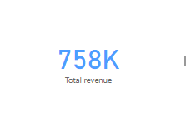
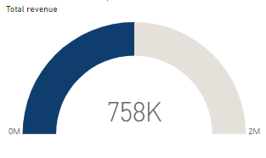
1.What was the total revenue generated by the company over the course of the year?
Here is the total revenue generated by company over the year.

Slide 5
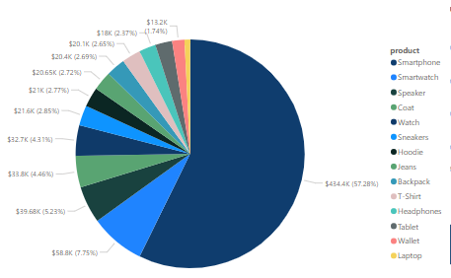
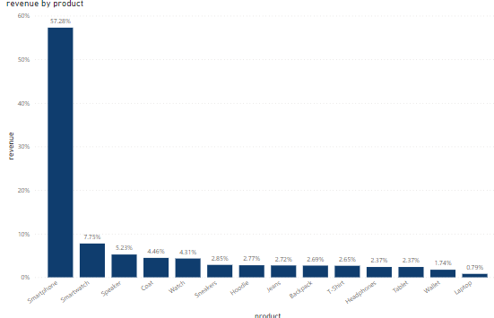
2.Which product had the highest revenue? How much revenue did it generate?
Smartphone had the highest revenue . That is $434.4k.

Slide 6
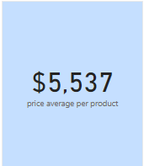
3.What was the average price of a product sold by the company?

Slide 7
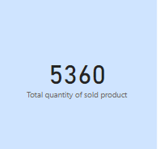
4.What was the total quantity of products sold by the company?
Here is the quantity of all products of every category which are sold by company.

Slide 8
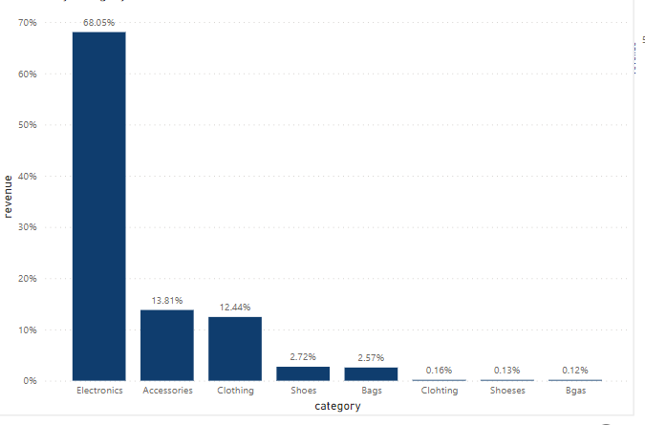
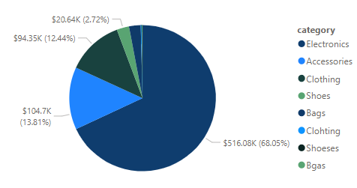
5.Which category had the highest revenue? How much revenue did it generate?
Electronics accounted for 68.05% of Sum of revenue

Slide 9
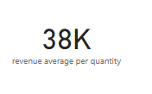
6.What was the average revenue per sale?

Slide 10
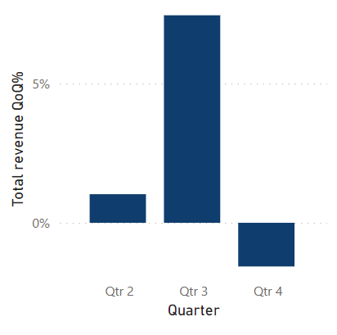
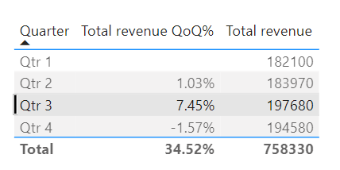
7.What was the total revenue generated in each quarter of the year? (i.e., Q1, Q2, Q3, Q4)

Slide 11
Summary
﻿We successfully find all the answers of question related to this project. We easily find the total revenue ,revenue by product and category, sold quantity, average revenue per sale and revenue per quarter. At 7.45%, qtr 3 had the highest total revenue QoQ% and was 575.22% higher than qtr 4, which had the lowest total revenue QoQ% at -1.57%.﻿Qtr 3 had the highest total revenue QoQ% at 7.45%, followed by qtr 2 at 1.03% and qtr 4 at -1.57%.﻿Qtr 2 had 1.03% total revenue QoQ%, qtr 3 had 7.45%, and qtr 4 had -1.57%.

